Slide 1
Airbnb Data Challenge EDA
Understand dataset
Single variable analysis
How each variable impacts successes
Interactive effects of variables on successes
Notes:
Title less technical

Slide 2
Understand Dataset

Slide 3
Overview of Data
Contacts:
There are 27887 unique inquiries with 14 variables
Inquiries are made through 3 channels: Contact me, Book it, and Instant book
Timestamps of inquiries being sent, replied, accepted, and/or booked is recorded
Guest size, guest’s user stage, and total number of interactions between guest and host are given for each inquiry
Listings:
There 13038 unique listings with 4 variables
There are 3 room type sfor listings: Entire home/apt, private room and shared room
Listings are located in 68 neighborhoods
Total number of reviews is included for each listing
Users:
There are 31457 users after dropping 68 duplicated ones, with 3 variables
Both guests and hosts’ profile information are included in the table

Slide 4
Sanity Check - Assumptions
Contacts
Inquiry/reply/accept/book timestamps:
ALL channels:
Inquiry time ≤ reply time ≤ accept time ≤ book time
All accepted inquiries must be replied
All booked inquiries must be accepted
Book it:
Accept time = book time
Instant book:
Inquiry time = reply time = accept time = book time
Guest size ≥ 1, total number of interactions ≥ 1, and message length ≥ 0
Listings:
Number of reviews ≥ 0
Users:
Profile length ≥ 0

Slide 5
Sanity Check - Results and Treatments
Contacts
Inquiry/reply/accept/book timestamps:
ALL channels:
452 inquiries where the inquiry time > reply time with lags between 1-70 seconds
Updated the reply time to be the same as inquiry time
Book it:
257 accepted but not booked, 152 inquiries where book time ≠ accepted time
Updated the book time to be the same as accept time
Instant book:
40 inquiries where acceptance and booking did not happen at the same hour (allowed the latency of an hour)
Filtered out these inquiries assuming they are erroneous records

Slide 6
Sanity Check - Results and Treatments
Contacts:
Guest size:
4 inquiries where number of guests is 0:
Filtered out these inquiries assuming they are erroneous records
Listings:
Number of reviews:
40 listings with negative number of reviews:
Replaced with medium

Slide 7
Merge Data
Guest information:
Merged guest information from ‘Users’ to ‘Contacts’, by ‘id_guest_anon’ in ‘Contacts’ and ‘id_user_anon’ in ‘Users’
Host information:
Merged host information from ‘Users’ to ‘Contacts’, by ‘id_host_anon’ in ‘Contacts’ and ‘id_user_anon’ in ‘Users’
Listing information:
Merged listing information from ‘Listings’ to ‘Contacts’, by ‘id_listing_anon’ in both datasets

Slide 8
Overview of Data After Cleaning
Before/After | Inquiries | Replied | Accepted | Booked
Contact me | 12,828/12,814 | 11,659/11,645 | 5,482/5,476 | 911/909
Book it | 8,366/8,352 | 7,503/7,492 | 4,240/4,237 | 3,983/3,980
Instant book | 6,693/6,682 | 6,693/6,682 | 6,693/6,682 | 6,693/6,682
Total | 27,887/27,848 | 25,855/25,819 | 16,415/16,395 | 11,587/11,571
27,848 valid inquiries were made by 22,540 unique guests
There were for 12,812 unique listing of 8,954 unique hosts

Slide 9
II. Individual Variable Analysis

Slide 10
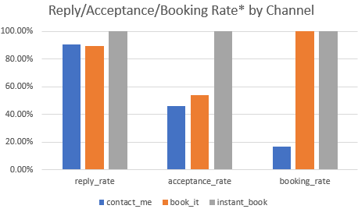
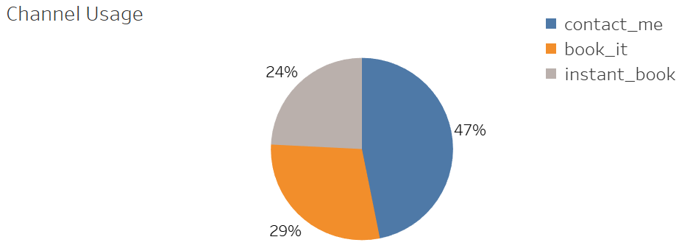
Overview of 3 Channels
Almost half (47%) of the inquiries are made through contact me channel
Book it (29%) and Instant book (24%) almost equally share the other half
Reply rate (91%, 89%) and acceptance rate (46%, 54%) do not differ much between Contact me and Book it
Contact me channel has a low booking rate (17%)
*Reply/acceptance/booking rate = # inquiries replied/accepted/book divided by # inquiries made/replied/accepted.

Slide 11
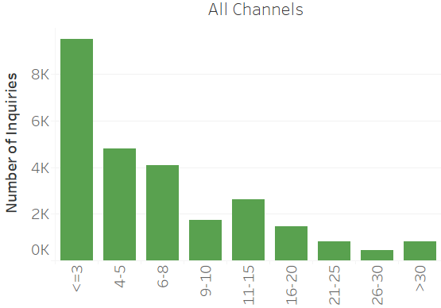
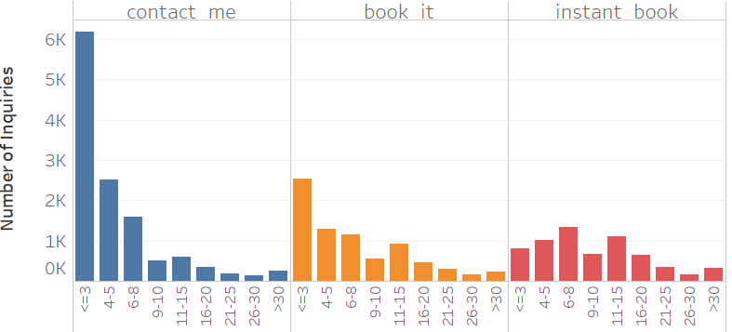
Interaction
50%, 33%, and 12% of the inquiries in contact me, book it and instant book channels have no more than 3 interactions, respectively
Average number of total interactions is lowest in contact me channel (6) and highest in instant book (12)

Slide 12
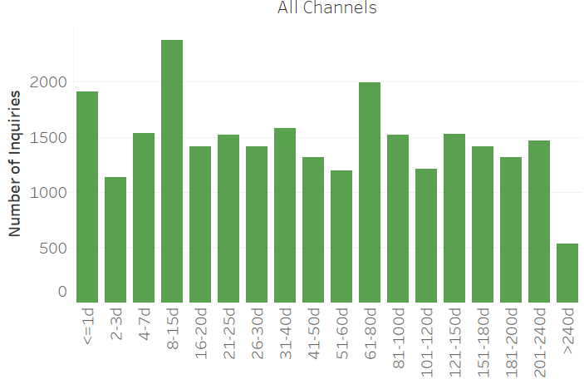
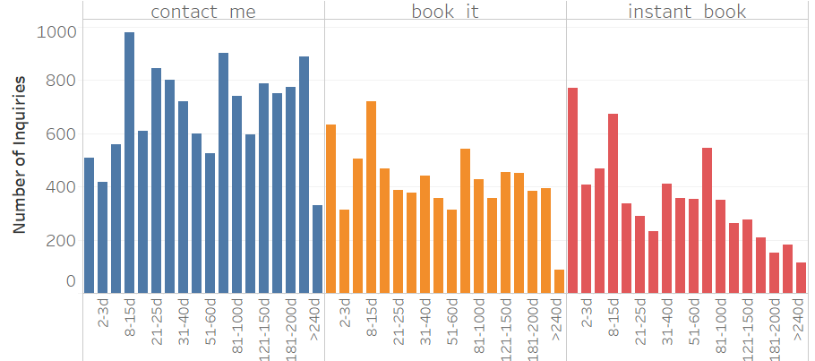
Lead time
The majority (75%) of inquiries have lead time shorter than 62 days for all channels
Lead time ranges from 0 - 378 days in contact me and instant book channel, 0 - 430 days in book it channel
Contact me channel has longer lead time(82 days) and instant book has shorter lead time (55 days) on average
Notes:
Change 2nd point

Slide 13
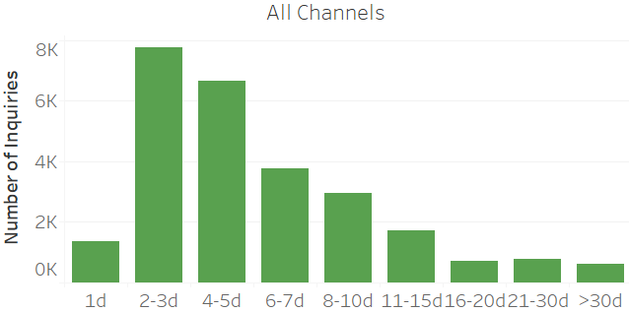
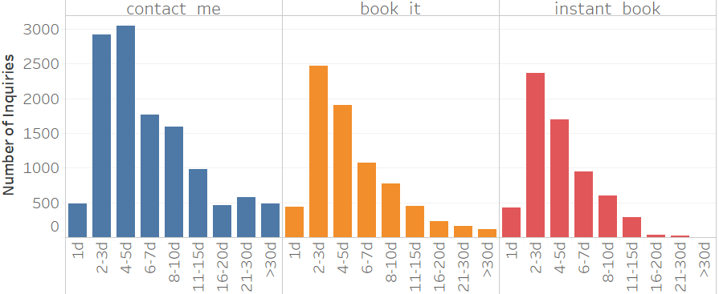
Duration of stay
The majority (55%) of the inquiries are for 2-5 days of stays for all channels
The majority (73%) of the inquiries for more than 15 days of stays are made in contact me channel
Contact me channel has longer length of stay than other channels on average
Notes:
Change 2nd point

Slide 14
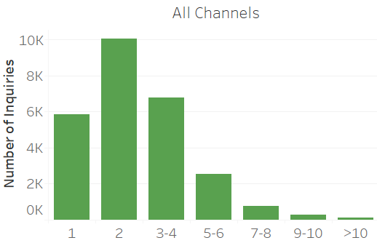
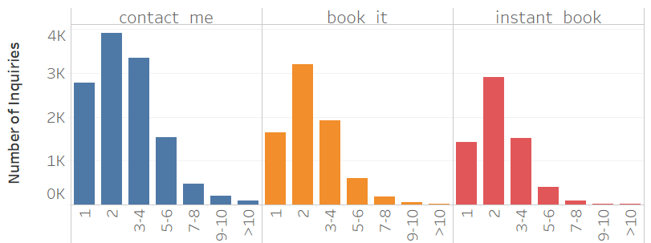
Guest size
86% of the inquiries are for no more than 4 guests and 38% of the inquiries are for 2 guests for all channels
Inquiries for 2 guests are most common for 3 channels
Contact me has higher average guest size (3) than instant book
Notes:
Add percentage to majority
Average diff

Slide 15
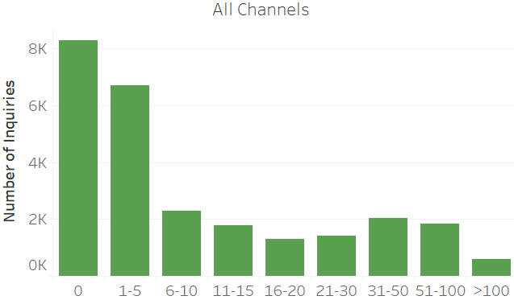
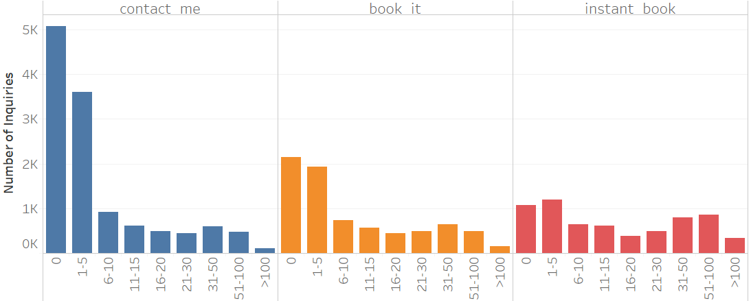
Reviews
Most (57%) of the listings have no more than 5 reviews for all channels
41%, 28%, and 17% of the inquiries made in contact me, book it and instant book channel are for listings with 0 reviews
Listings with 0 - 5 reviews are most common for contact me and book it channels, whereas listings with 31 - 100 reviews are popular in instant book as well
Majority (55%) of inquiries for listings with more than 100 reviews are made in instant book channel
Inquiries made through instant book channel have more reviews on average

Slide 16
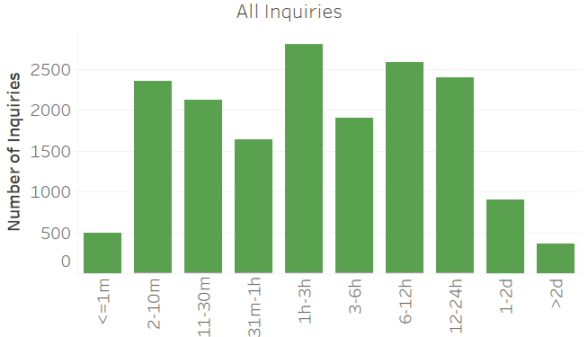
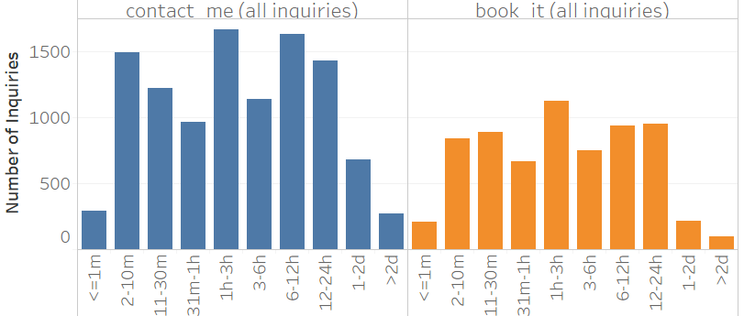
Reply time
95% of the inquiries in both channels are replied within 1 day
14% of the inquiries are replied with in 1 - 3 hours
Longest reply time is 6 days for contact me channel 410 days for book it channel
Reply time in contact me channel is longer than book it channel on average

Slide 17
III. How each variable impacts successes (contact me and book it only)

Slide 18
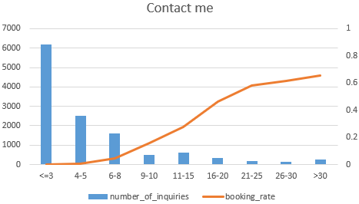
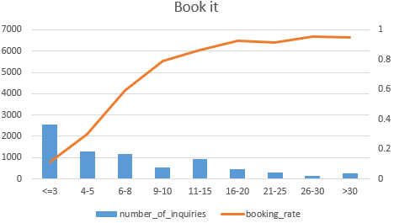
Interactions* and Booking rate
50% and 33% of the inquiries in contact me and book it channel have no more than 3 interactions, respectively
More interactions are associated with higher booking rate for both channels, while the effect is stronger for book it channel
After 25 interactions for contact me channel and after 20 interactions for book it channel, the increase starts to slow down
* Prior/post booking interactions are both included here due to limitation of dataset
Notes:
2nd point: For all inquiries or successful?
Inflextion point

Slide 19
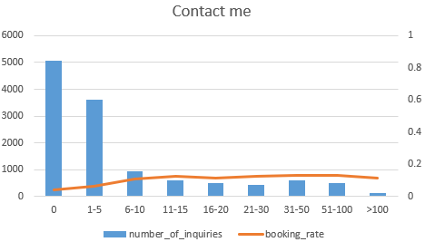
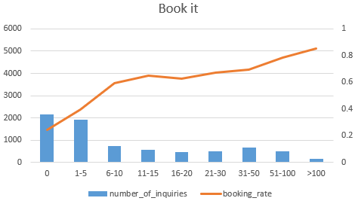
Reviews and Booking rate
70% inquiries made in contact me channel were for listings with no more than 5 reviews with booking rate less than 7%
53% inquiries made in book it channel were for listings with no more than 5 reviews with booking rate less than 40%
Having at least 11 reviews drives booking rate up to 13% in contact me channel and 65% in book it channel
Having more than 50 reviews drives booking rate up to 78% and reaches 85% when review > 100, in book it channel
However, booking rate starts to decline after 100 reviews for contact me channel
Notes:
Review more than 5 provide higher success rate for both channel, beyond that reciew positively infect

Slide 20
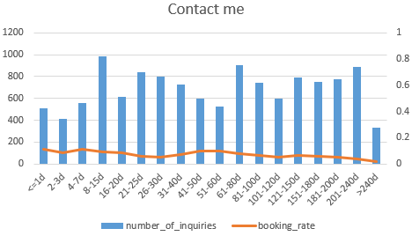
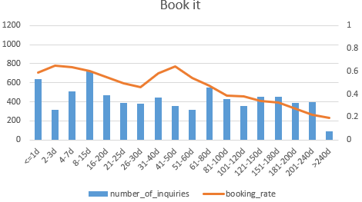
Lead time and Booking rate
27% of inquiries made within 1 day before check in are in contact me channel, and 33% in book it channel
For book it channel, inquiries made closer to checkin date have higher booking rate overall, except for inquiries made 41 - 50 days before check in, whose success rate (65%) is the same as inquiries made 2 -3 days before check in
Lead time has no strong impact on success for contact me channel

Slide 21
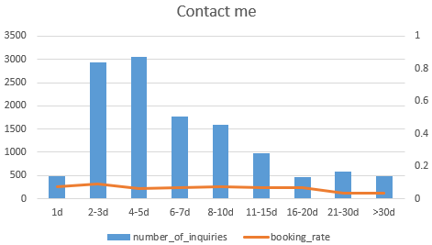
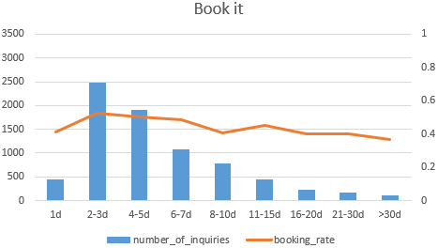
Duration of stay and Booking rate
The majority (61%) of trips longer than 7 days are in contact me channel
Trips of 2 or 3 days are most likely to be booked for both channels
The longer the stay, the lower the success rate for Book it channel
Success rate starts to decline when trips are longer than 7 days for book it channel

Slide 22
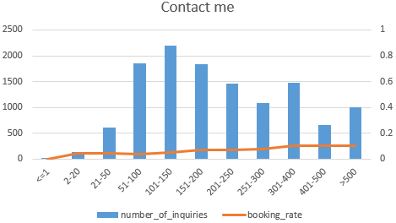
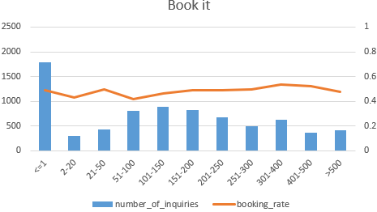
Message length and Booking rate
18% of the inquires in contact me channel contains 100 -150 characters, 23% of the inquiries on book it channel contains less than 1 characters
Longer(>50 characters) messages tend to be sent in contact me channel, short (<20 characters) tend to be sent in book it channel
Longer messages are associated with higher booking rate for contact me channel, but the increase is slow
For book it channel, messages with either 20 - 50 or 300 - 400 characters are most likely to be booked, otherwise there is not a obvious trend between message length and booking rate

Slide 23
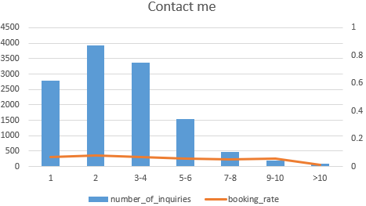
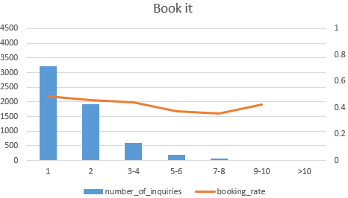
Guest size and Booking rate
The majority (36%) of single guests chose book it channel, whereas contact me channel dominates over other guest sizes
Inquiries for single guest have the highest success rate for in book it channel
More guests are associated with low booking rate for both channels

Slide 24
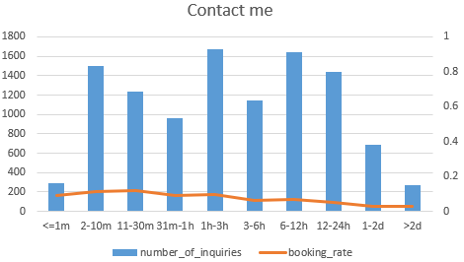
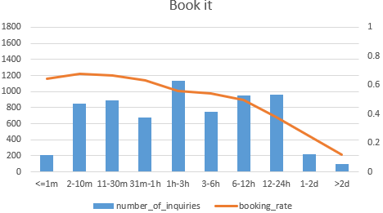
Reply time and Booking rate
Contact me channel dominates over all reply time bins
Longer reply time is associated with lower booking rate for both channels, whereas the decrease is much stronger in book it channel
Inquiries replied within 30 mins are most likely to be booked for both channels
In book it channel, replies time longer than 1 hour drags booking rate below 70%, those longer than 12 hours drags booking rate below 50%

Slide 25
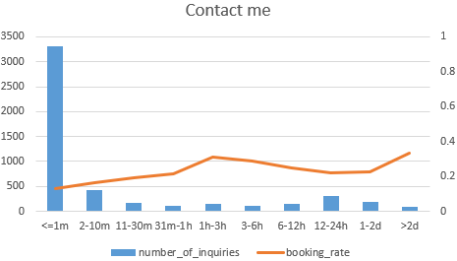
Accept time v.s. Booking rate
For contact me channel, inquiries accepted within 1-3 hours after reply are most likely to be booked
Accept time shorter or longer than this time frame are all less likely to be booked

Slide 26
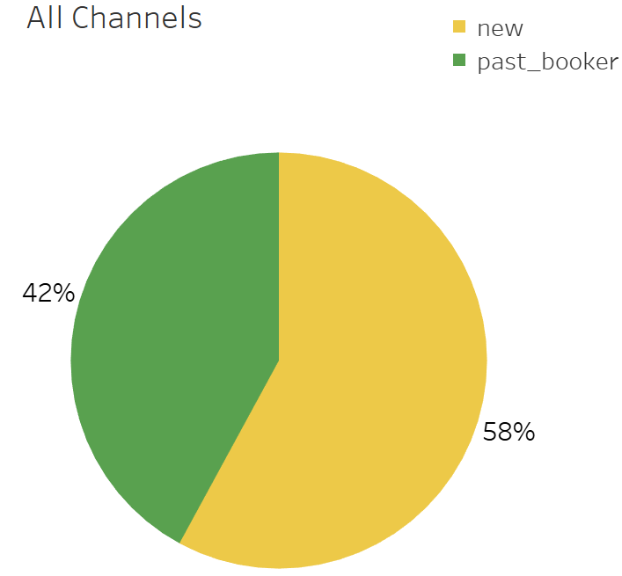
User stage and Booking rate
# of inquiries booking rate | New booker | Past Booker
Contact me | 8550 6% | 3810 9%
Book it | 4007 46% | 3635 50%
Total (Excluded Instant book) | 12557 19% | 7445 29%
The majority (56%) of new users chose contact me channel, 26% chose book it channel
Inquiries made by past bookers have higher success rate for both contact me and book it channels
Inquiries made in book it channel has higher success rate for both user stages

Slide 27
IV. Interactive effects of variables on successes (contact me and book it only)

Slide 28
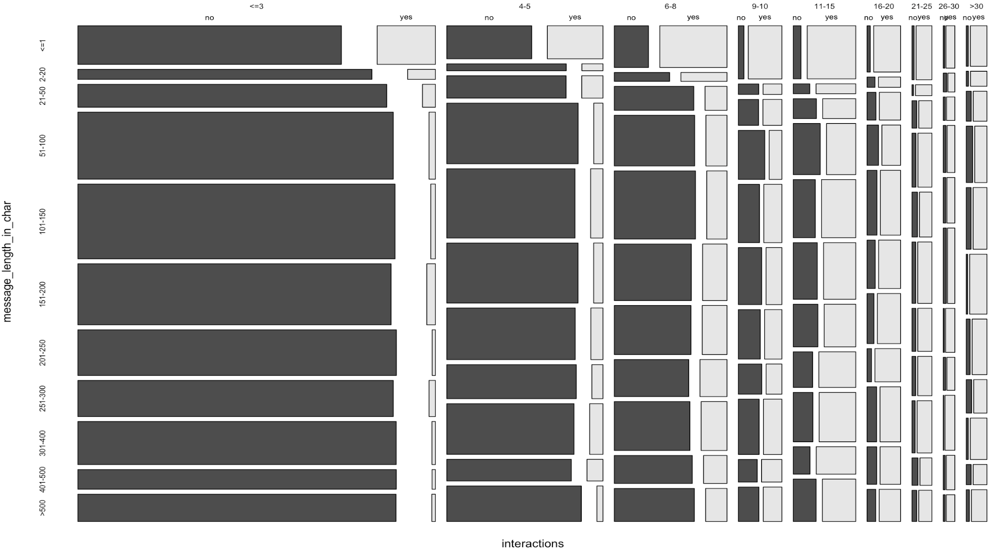
Message + Interaction
Regardless of message length, when # of interactions >11, it will lead to more bookings than non booking.
When # of interactions > 11, it can make up for the lack in message length, and turn an inquiry into a successful booking.
When message length is >20, more interactions are needed in order to turn an inquiry into a successful booking. This could be due to the fact that a longer message reflects the complexity of a stay request, therefore needing more interactions between the host and the guest in order for it to be successful.

Slide 29
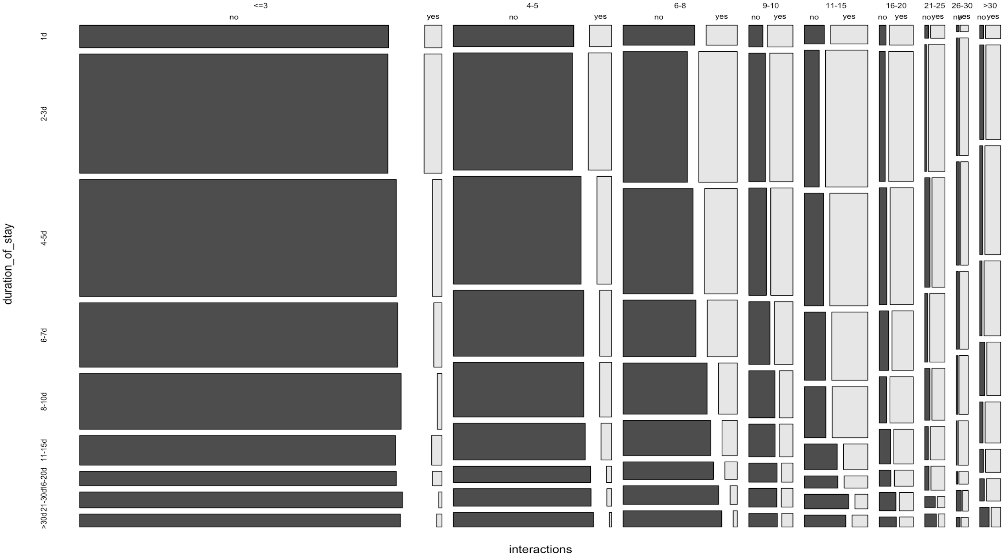
Duration of stay + Interaction
When days of stay > 3 regardless of number of interactions, it will significantly improve the booking success.
However, when number of interactions is more than 20, it no longer matters how long the stays are, which means, more than 20 interactions might be able to sufficiently make up for the lack of reviews.

Slide 30
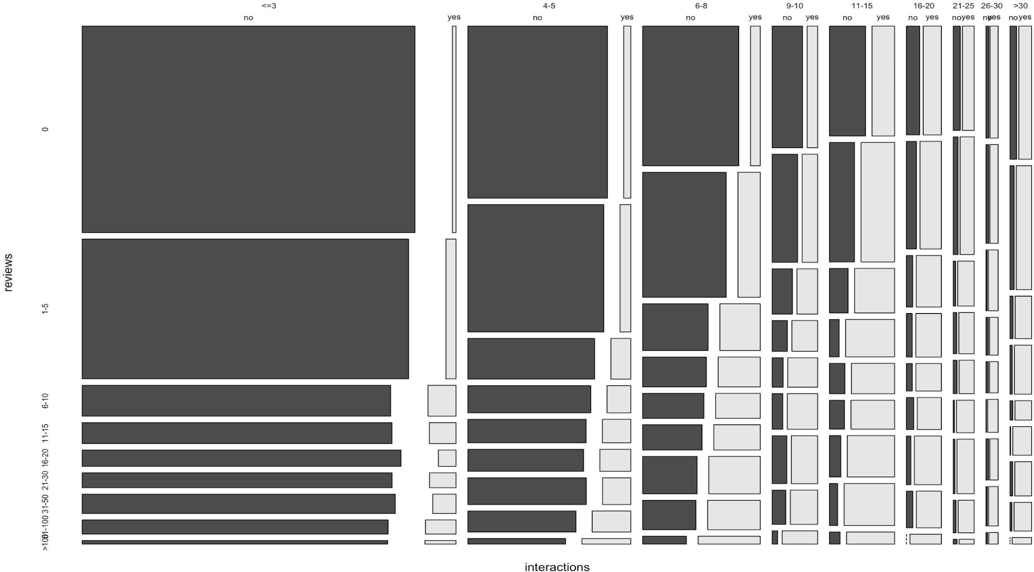
Review + Interaction
When an inquiry has more than 5 reviews, regardless of number of interactions, it will significantly improve the booking success.
However, when number of interactions is more than 20, it no longer matters when an inquiry has fewer or more than 5 reviews, which means, more than 20 interactions might be able to sufficiently make up for the lack of reviews.

Slide 31
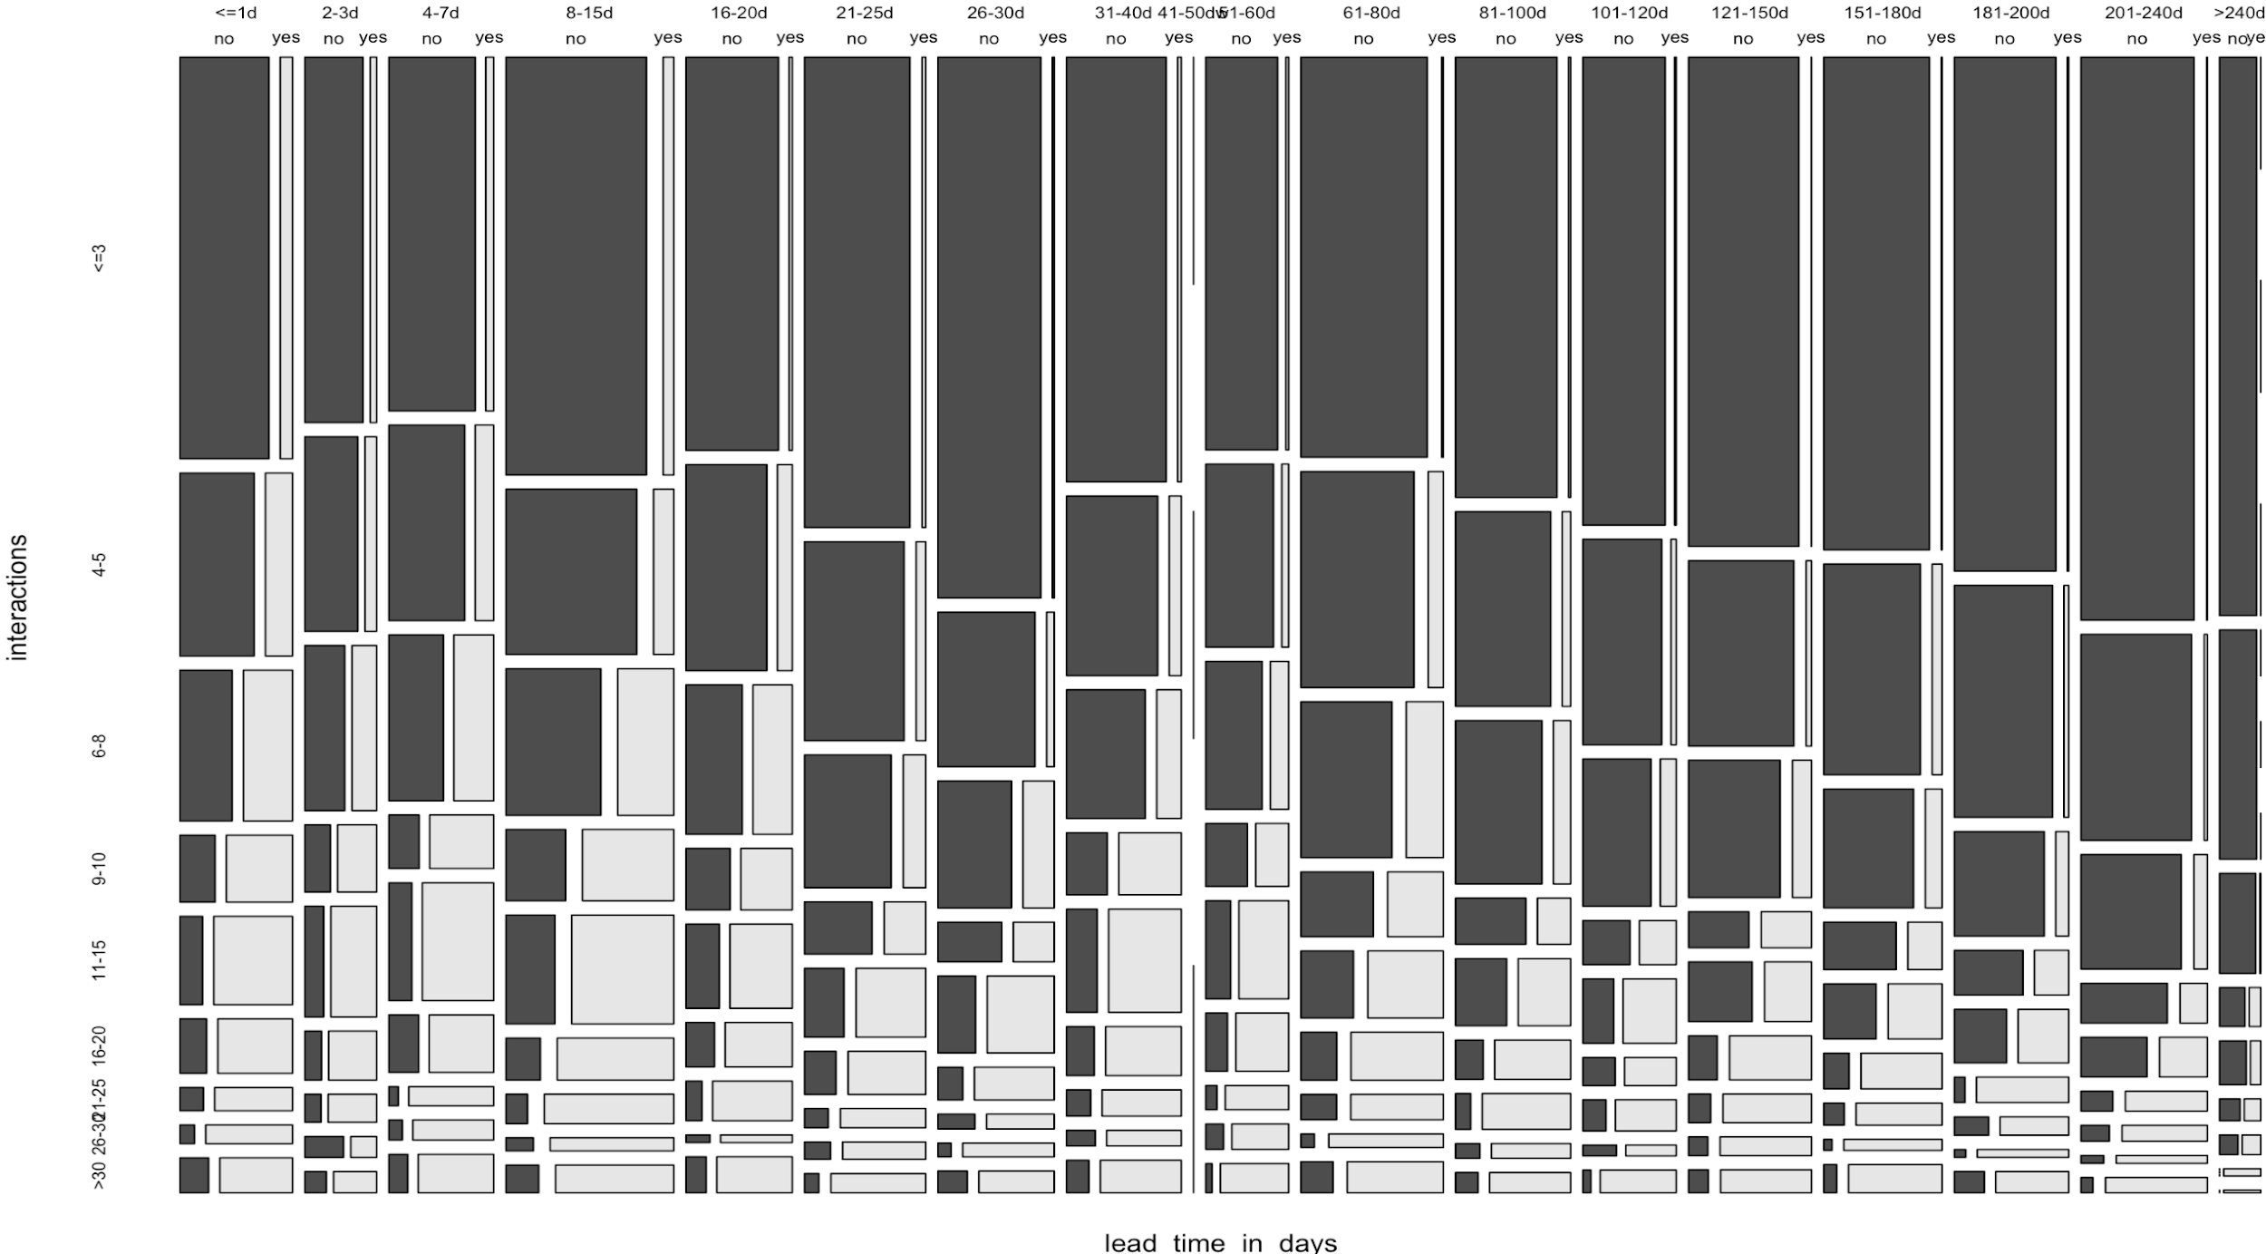
Interaction + Lead time
Regardless of lead time, when # of interactions >11, it will lead to more bookings than non booking.
Therefore, having more than 11 interactions can make up for the long lead times, and turn an inquiry into a successful booking.

